Slide 1
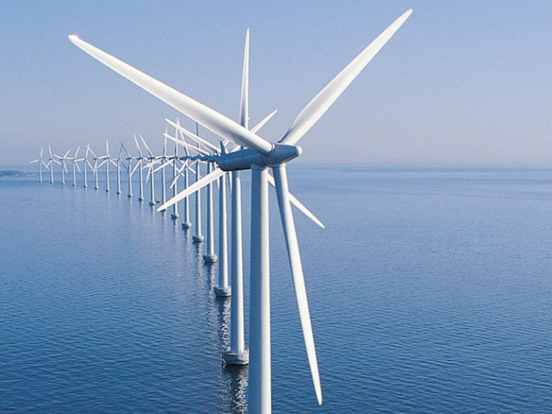
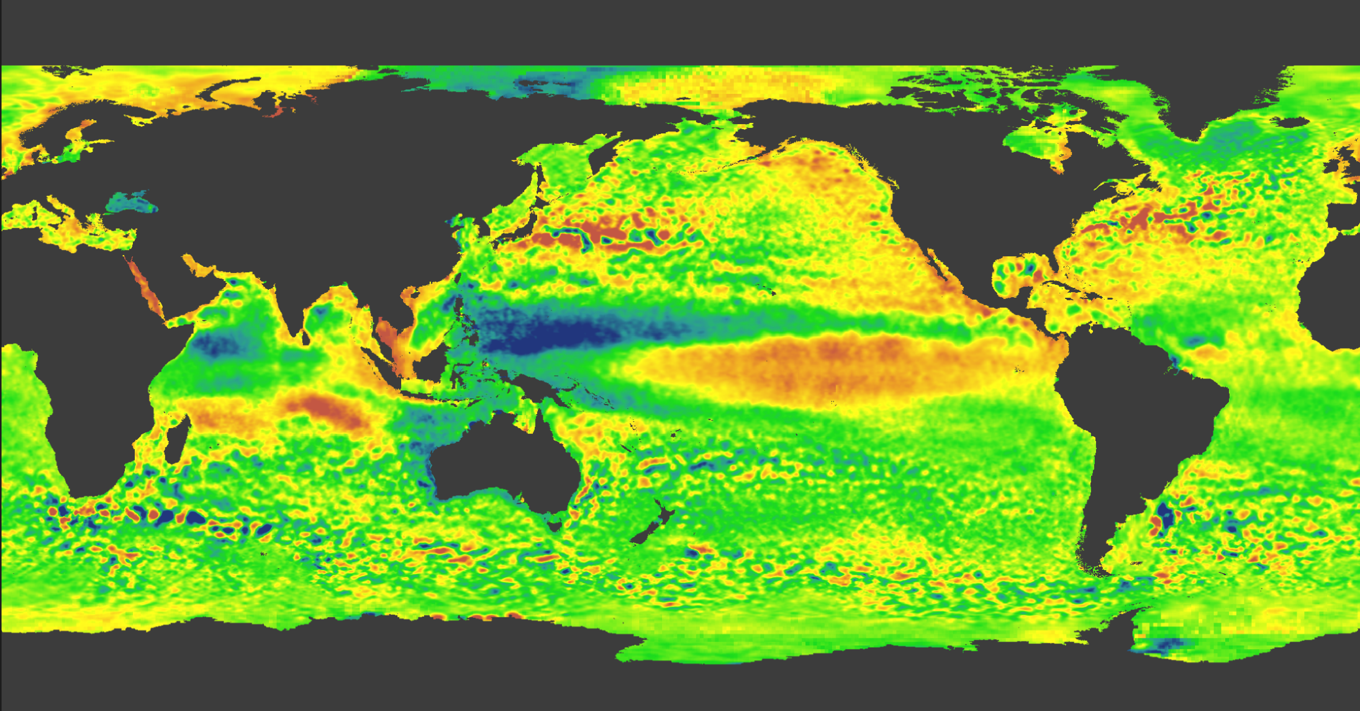
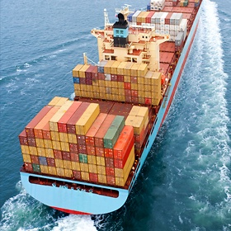
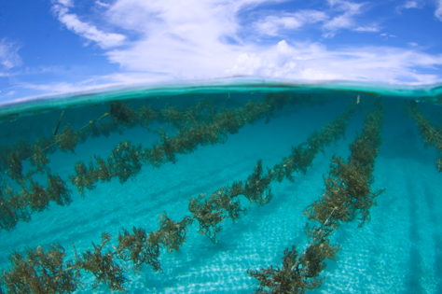
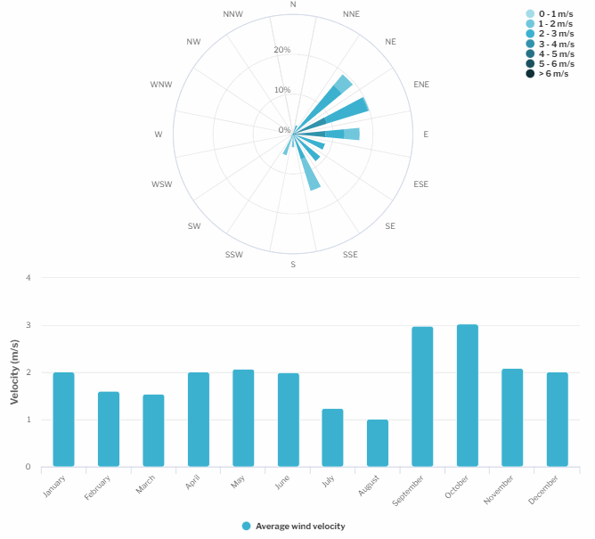
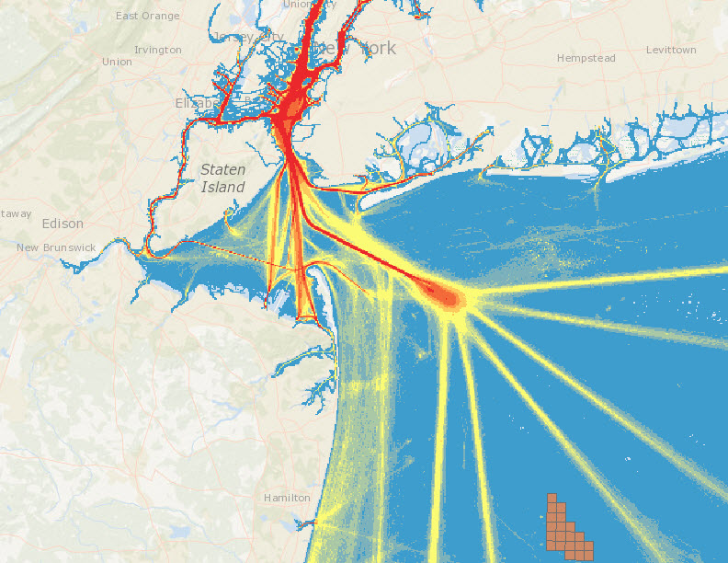



Gulf of Maine Cable Routing - Stellwagen Bank
NOAA OSW Spatial Team
James.Morris@noaa.gov

Slide 2
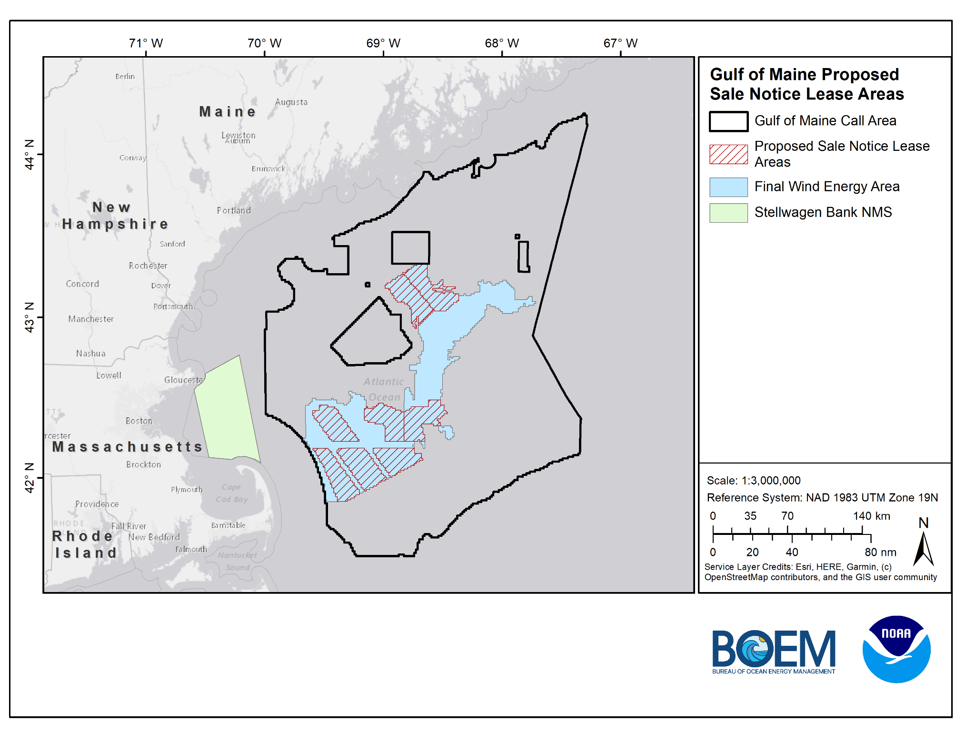
Proposed Sale Notice Lease Areas

Slide 3
Model Iterations
Model 2.1 - MA CZM Base Case
Model 2.2 - MA CZM Base Case (Cod Removed)
Model 2.3 - NMS Base Case
Model 2.4 - NMS Base Case (North of TSS)
Model 2.5 - NMS Base Case (South of TSS)
Model 2.6 - MA CZM Base Case (Cod Removed) - North of TSS - Merrimack River end point)
Notes:
So this data inventory will be developed and updated as outreach and engagement continues with stakeholders.

Slide 4
General Modeling Parameters
1,000-m wide corridors
50-m x 50-m square grid (consistent with MA CZM)
Points of Interconnection (End Points)
Boston
Plymouth
Data layers are scored 0 - 1 for inclusion in Least Cost Path Analysis; score closer to 0 is more suitable (lower cost), score closer to 1 is less suitable (higher cost)
Notes:
Roughly 0.01 ac resolution
So this data inventory will be developed and updated as outreach and engagement continues with stakeholders.

Slide 5
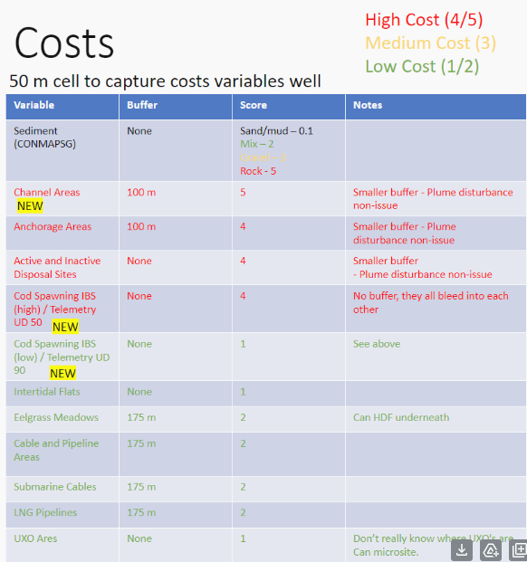
MA CZM Data/Scoring
NCCOS converted scores to fit 0 -1 scoring scale:
1 = 0.2
2 = 0.4
3 = 0.6
4 = 0.8
5 = 1
Notes:
So this data inventory will be developed and updated as outreach and engagement continues with stakeholders.

Slide 6
Model 2.1
MA CZM Base Case
Notes:
So this data inventory will be developed and updated as outreach and engagement continues with stakeholders.

Slide 7
Model 2.1 Data & Scoring
Data Sets | Score
Sediment (CONMAPSG) - Sand/Mud | 0.2
Sediment (CONMAPSG) - Mix | 0.4
Sediment (CONMAPSG) - Gravel | 0.6
Sediment (CONMAPSG) - Rock | 1
Cod Spawning IBS (High)/Telemetry (UD 50) | 0.8
Cod Spawning IBS (Low)/Telemetry (UD 90) | 0.2
Active and Inactive Disposal Sites - (500-m setback) | 0.8
Intertidal Flats - (500-m setback) | 0.2
Sand Patches - (500-m setback) | 1
Channel Areas - (600-m setback) | 1
Anchorage Areas - (600-m setback) | 0.8
Eelgrass Meadows - (675-m setback) | 0.4
Cable and Pipeline Areas - (675-m setback) | 0.4
Submarine Cables - (675-m setback) | 0.4
LNG Pipelines - (675-m setback) | 0.4
*Note recommended setback distances include an additional 500-m to account for a 1-km cable corridor, LCP analysis identifies a line, which is then given a 500-m setback
Notes:
So this data inventory will be developed and updated as outreach and engagement continues with stakeholders.

Slide 8
Model 2.1 Data & Scoring - Barriers
Barrier Data Sets | Score
Coral Points (MA CZM provided) - (675-m setback) | 0
Sites to Avoid (NMS provided) - (1000-m setback) | 0
Boulder Ridges (NMS provided) - (500-m setback) | 0
Cape 500-m setback from shore | 0
Notes:
So this data inventory will be developed and updated as outreach and engagement continues with stakeholders.

Slide 9
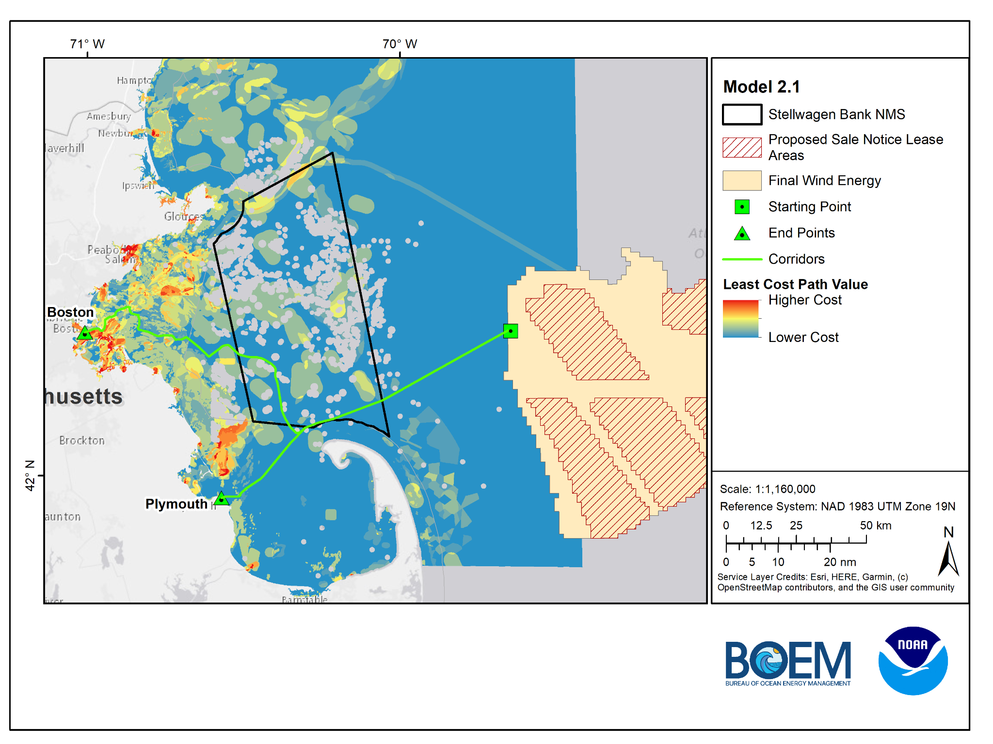
Model 2.1
MA CZM
Base Case
*Cod spawning areas are primarily driving the model
Boston Route = 101.5 miles
Plymouth Route = 66 miles

Slide 10
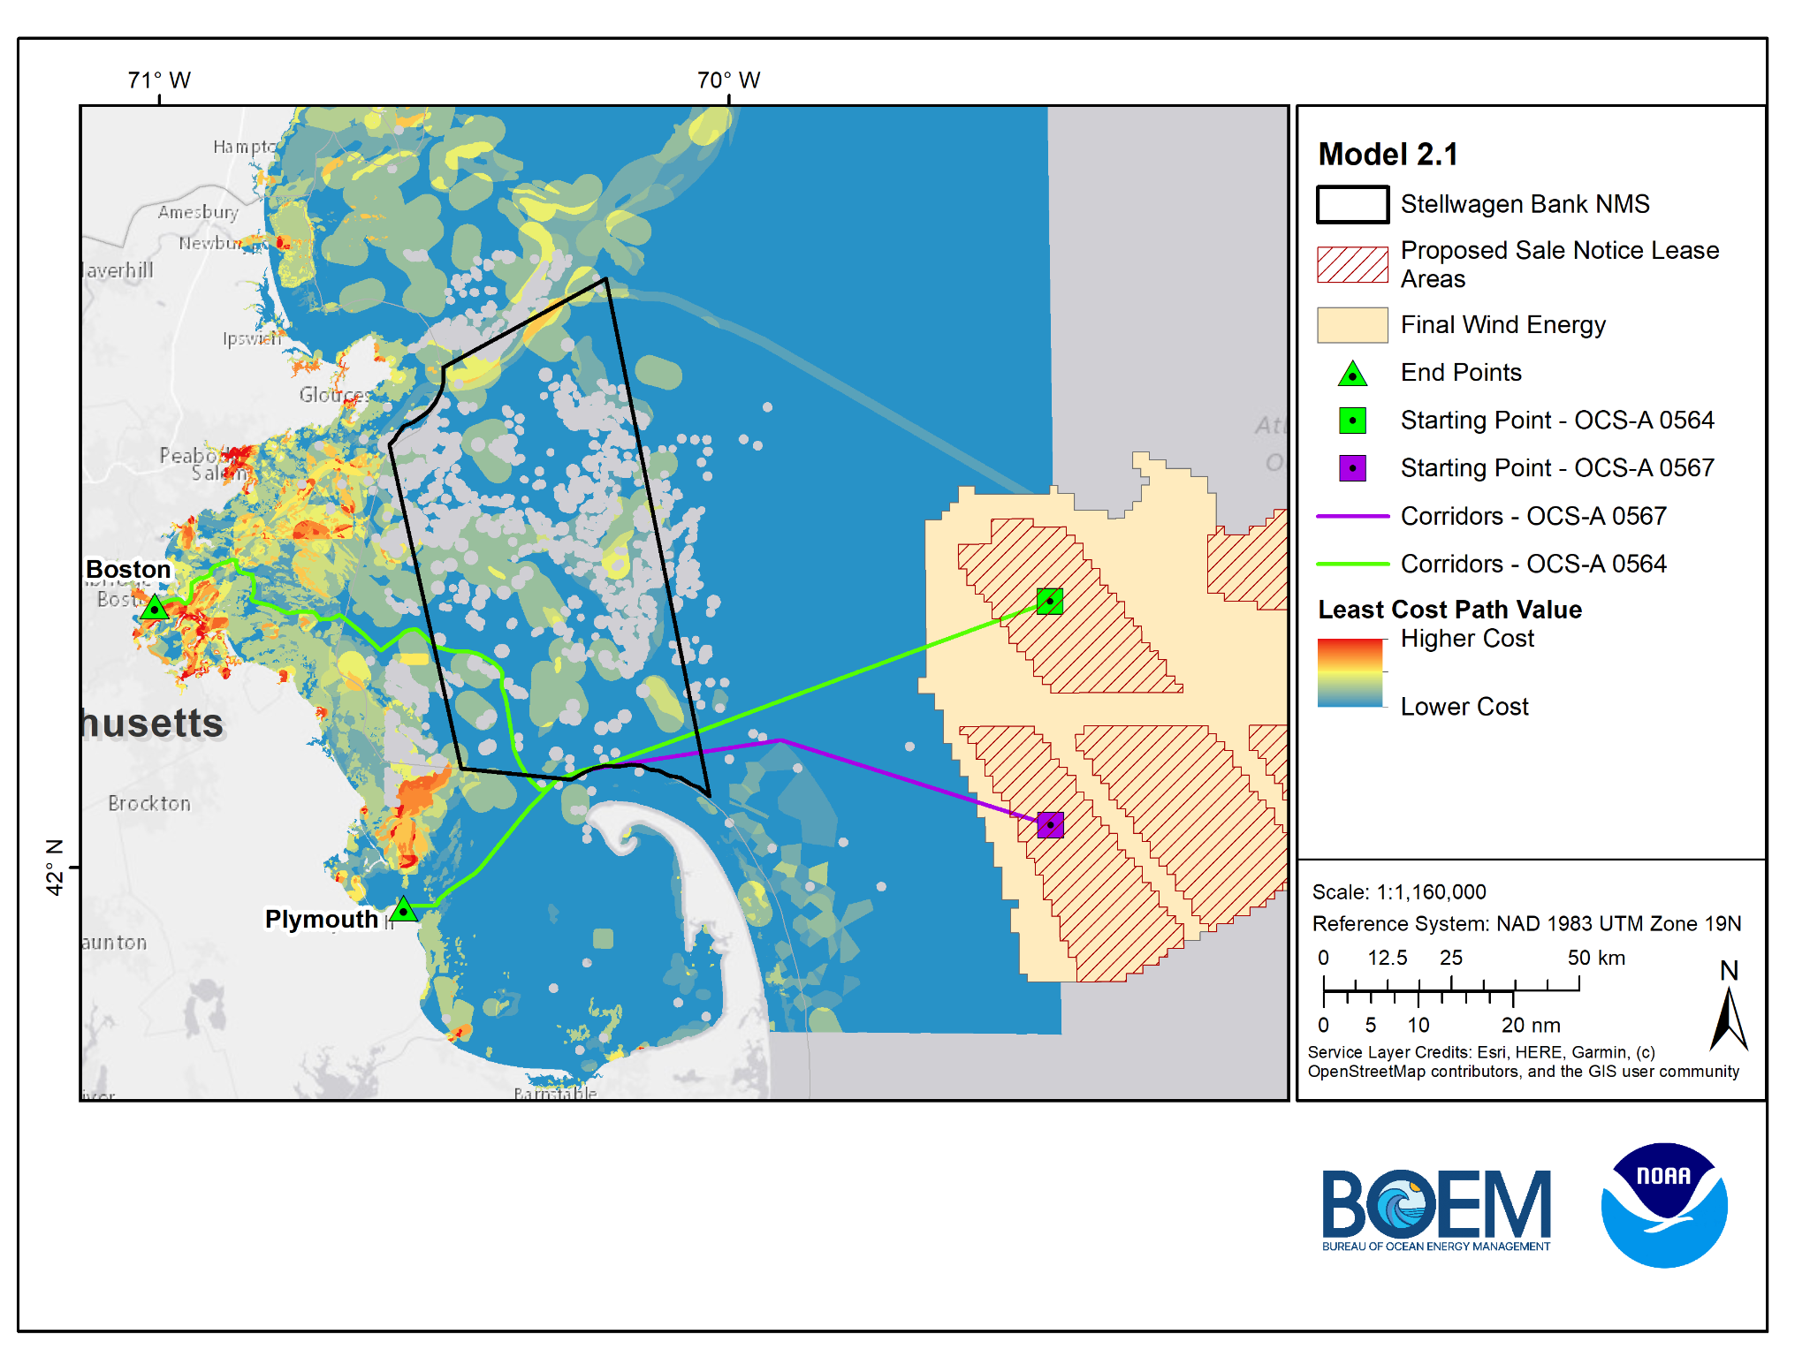
Model 2.1
MA CZM
Base Case
*Cod spawning areas are primarily driving the model
OCS-A 0564 Lease
Boston Route = 101.5 miles
Plymouth Route = 66 miles
OCS-A 0567 Lease
Boston Route = 100 miles
Plymouth Route = 64.9 miles

Slide 11
Model 2.2
MA CZM Base Case (Cod Removed)
Notes:
So this data inventory will be developed and updated as outreach and engagement continues with stakeholders.

Slide 12
Model 2.2 Data & Scoring
Data Sets | Score
Sediment (CONMAPSG) - Sand/Mud | 0.02
Sediment (CONMAPSG) - Mix | 0.4
Sediment (CONMAPSG) - Gravel | 0.6
Sediment (CONMAPSG) - Rock | 1
Cod Spawning IBS (High)/Telemetry (UD 50) | 0.8
Cod Spawning IBS (Low)/Telemetry (UD 90) | 0.2
Active and Inactive Disposal Sites - (500-m setback) | 0.8
Intertidal Flats - (500-m setback) | 0.2
Sand Patches - (500-m setback) | 1
Channel Areas - (600-m setback) | 1
Anchorage Areas - (600-m setback) | 0.8
Eelgrass Meadows - (675-m setback) | 0.4
Cable and Pipeline Areas - (675-m setback) | 0.4
Submarine Cables - (675-m setback) | 0.4
LNG Pipelines - (675-m setback) | 0.4
*Note recommended setback distances include an additional 500-m to account for a 1-km cable corridor, LCP analysis identifies a line, which is then given a 500-m setback
Notes:
So this data inventory will be developed and updated as outreach and engagement continues with stakeholders.

Slide 13
Model 2.2 Data & Scoring - Barriers
Barrier Data Sets | Score
Coral Points (MA CZM provided) - (675-m setback) | 0
Sites to Avoid (NMS provided) - (1000-m setback) | 0
Boulder Ridges (NMS provided) - (500-m setback) | 0
Cape 500-m setback from shore | 0
Notes:
So this data inventory will be developed and updated as outreach and engagement continues with stakeholders.

Slide 14
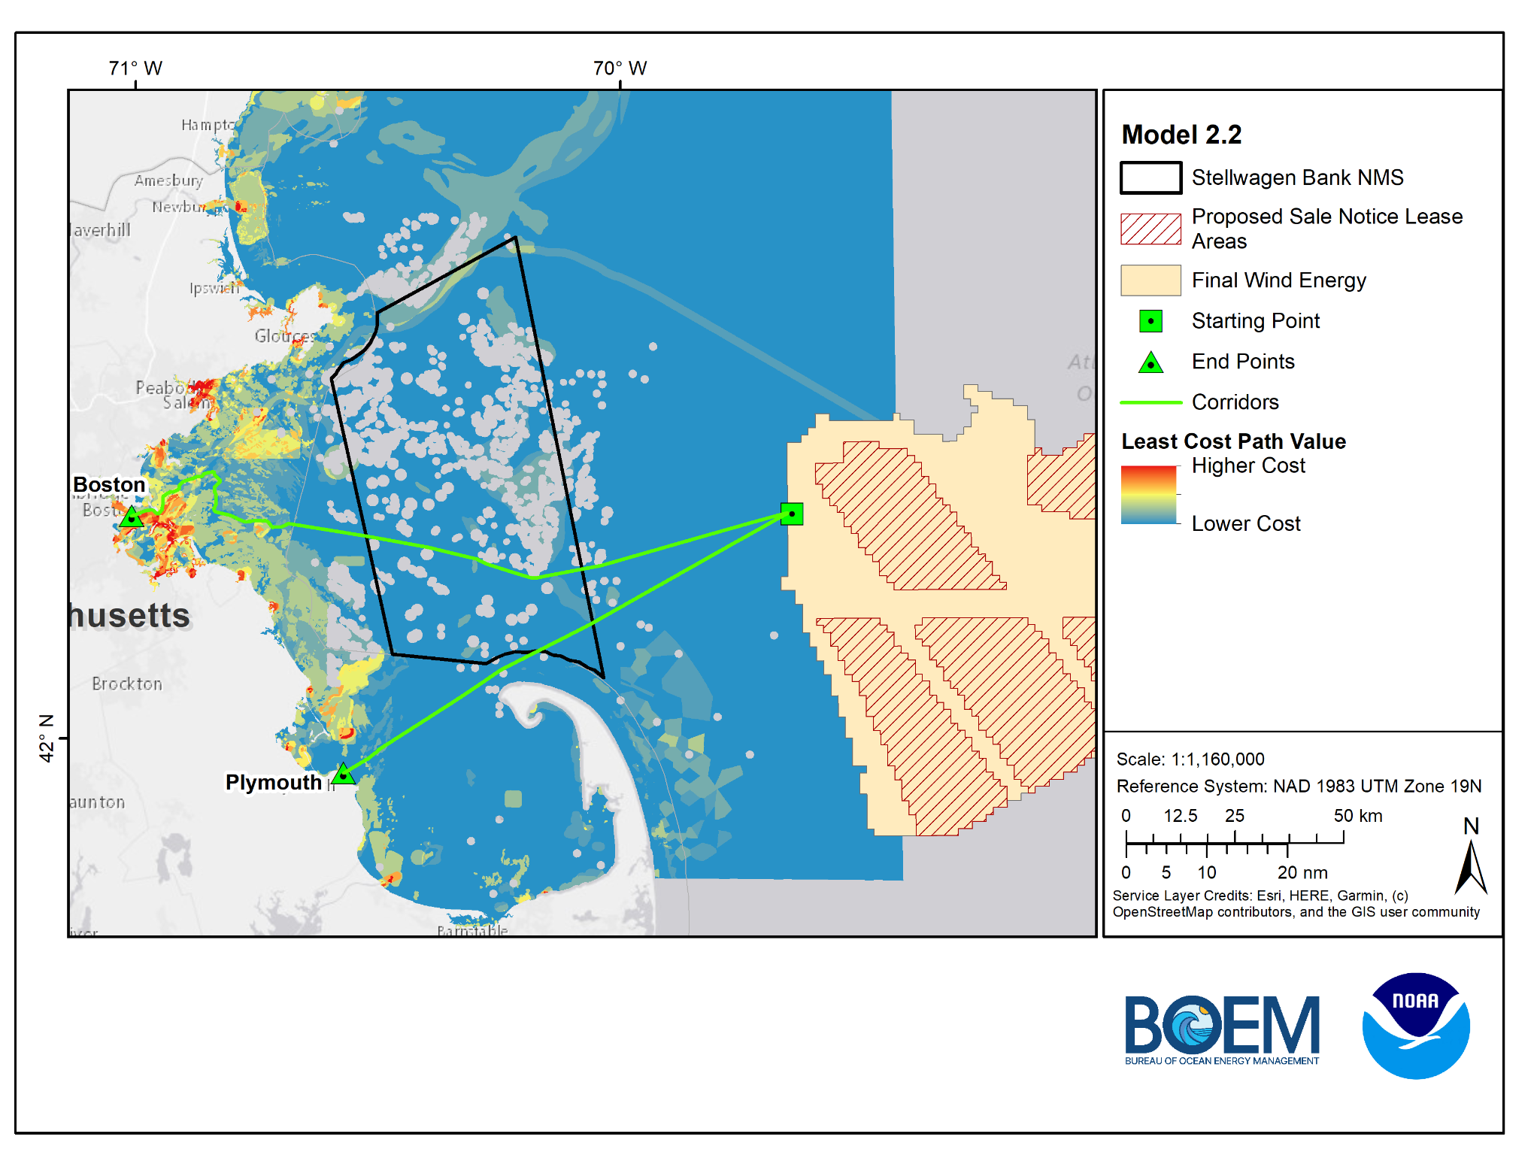
Model 2.2
MA CZM
Base Case
Removed Cod Spawning Areas
Boston Route = 79.2 miles
Plymouth Route = 54.6 miles

Slide 15
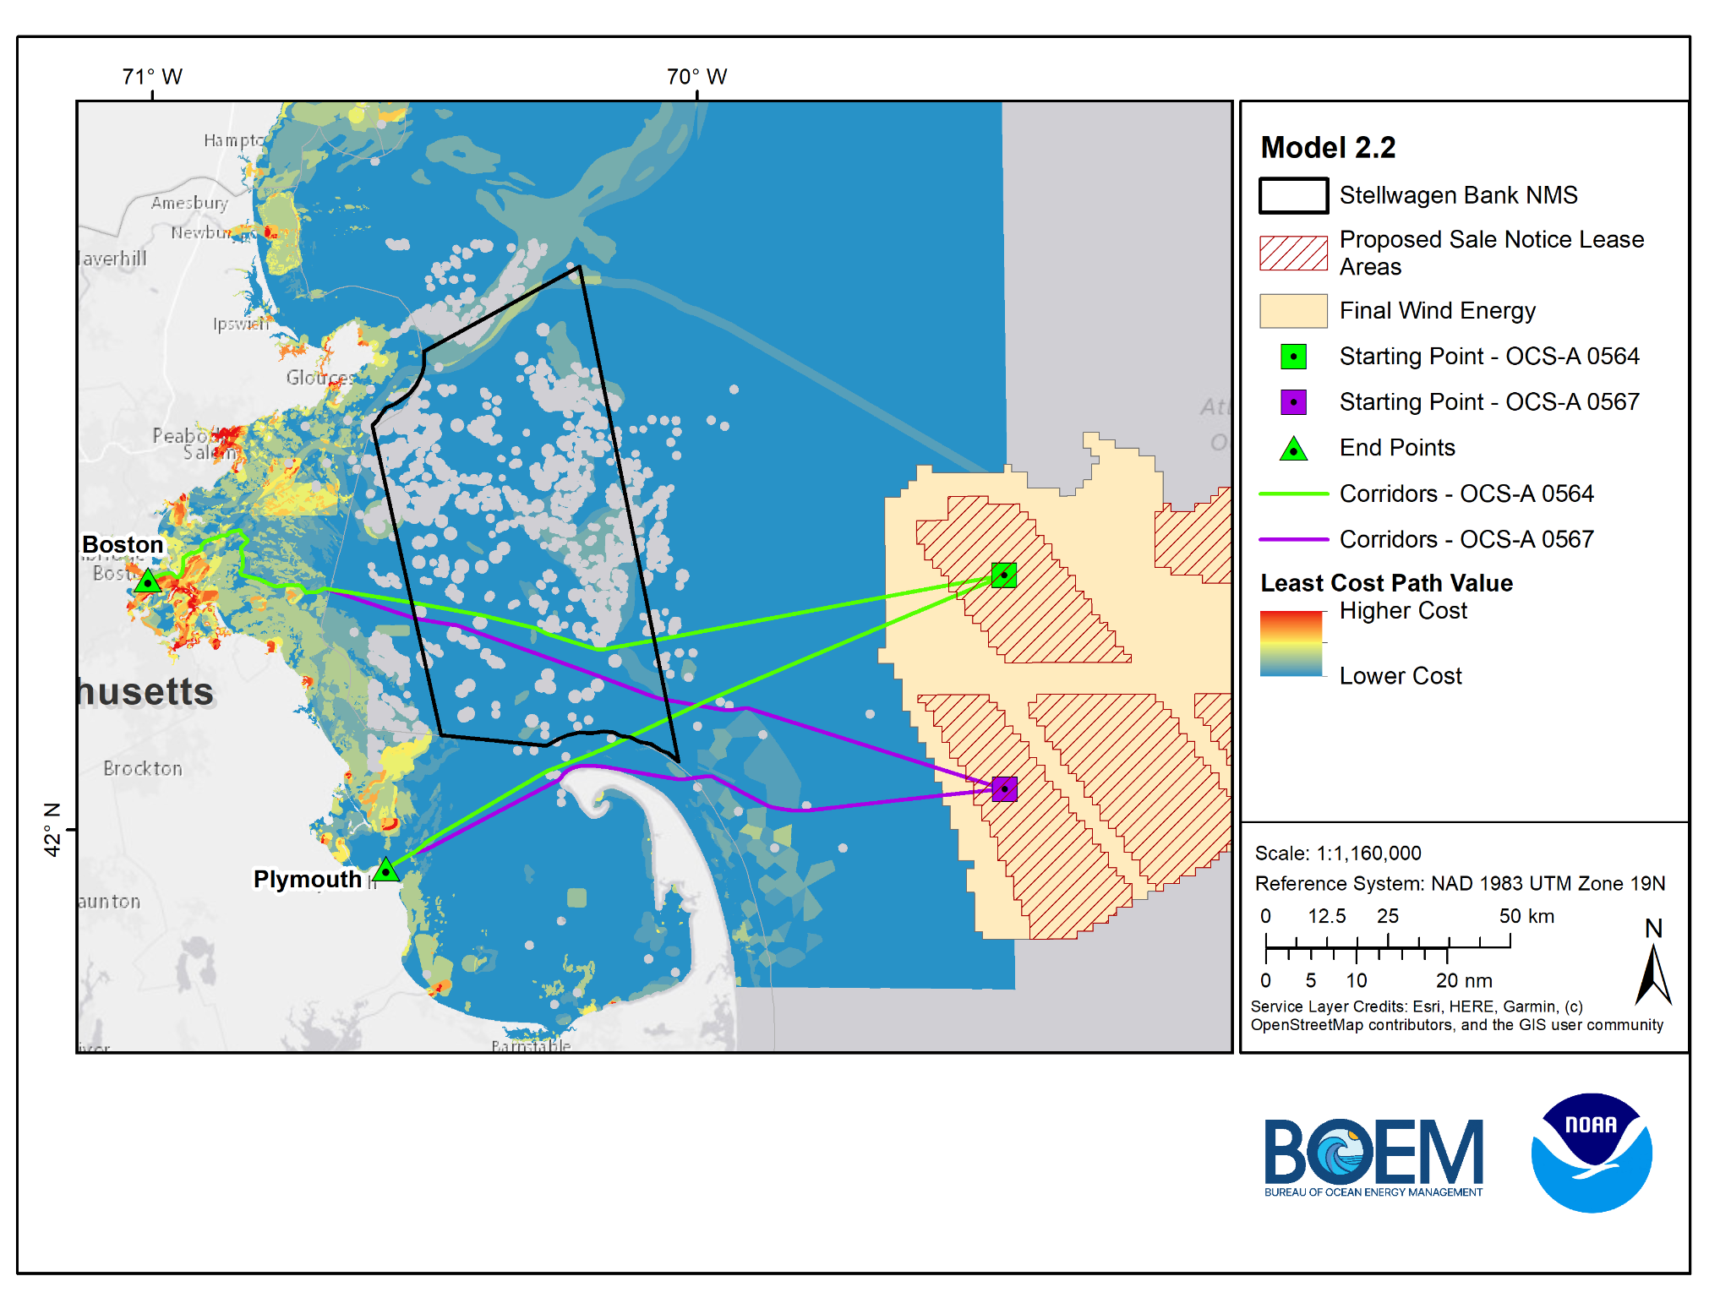
Model 2.2
MA CZM
Base Case
Removed Cod Spawning Areas
OCS-A 0564 Lease
Boston Route = 90.1 miles
Plymouth Route = 64.6 miles
OCS-A 0567 Lease
Boston Route = 92 miles
Plymouth Route = 62 miles

Slide 16
Model 2.3
NMS Base Case
Notes:
So this data inventory will be developed and updated as outreach and engagement continues with stakeholders.

Slide 17
Model 2.3 Data & Scoring
Model 2.3 Barriers
Data Sets | Score
NMS Sediment - Gravel | 0.5
Submarine Cables - (675-m setback) | 0.5
Slope (Flatter is better) | Increasing Linear
Barrier Data Sets | Score
Sites to Avoid (NMS provided) - (1000-m setback) | 0
Boulder Ridges (NMS provided) - (500-m setback) | 0
*Note recommended setback distances include an additional 500-m to account for a 1-km cable corridor, LCP analysis identifies a line, which is then given a 500-m setback
Notes:
So this data inventory will be developed and updated as outreach and engagement continues with stakeholders.

Slide 18
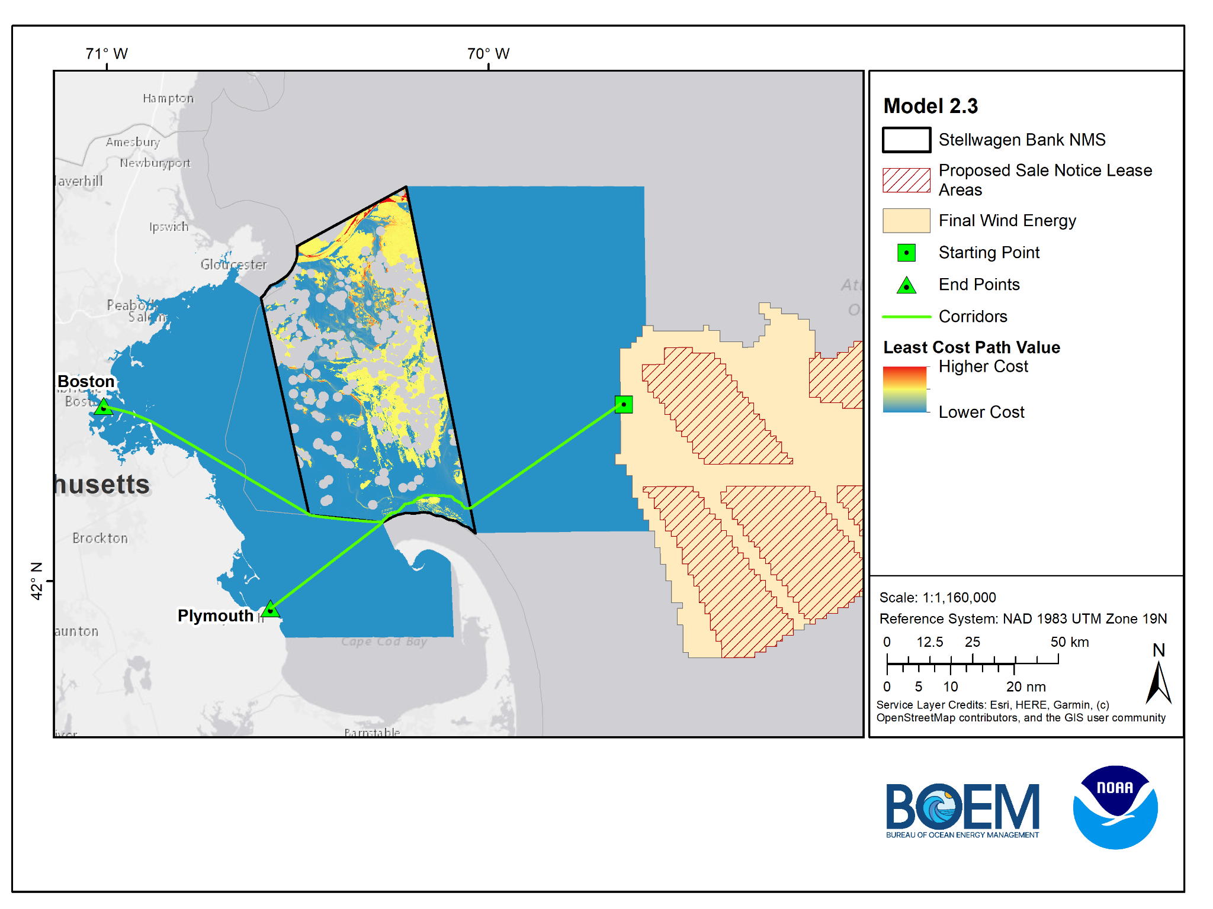
Model 2.3
NMS Base Case
Boston Route = 80.5 miles
Plymouth Route = 58.2 miles

Slide 19
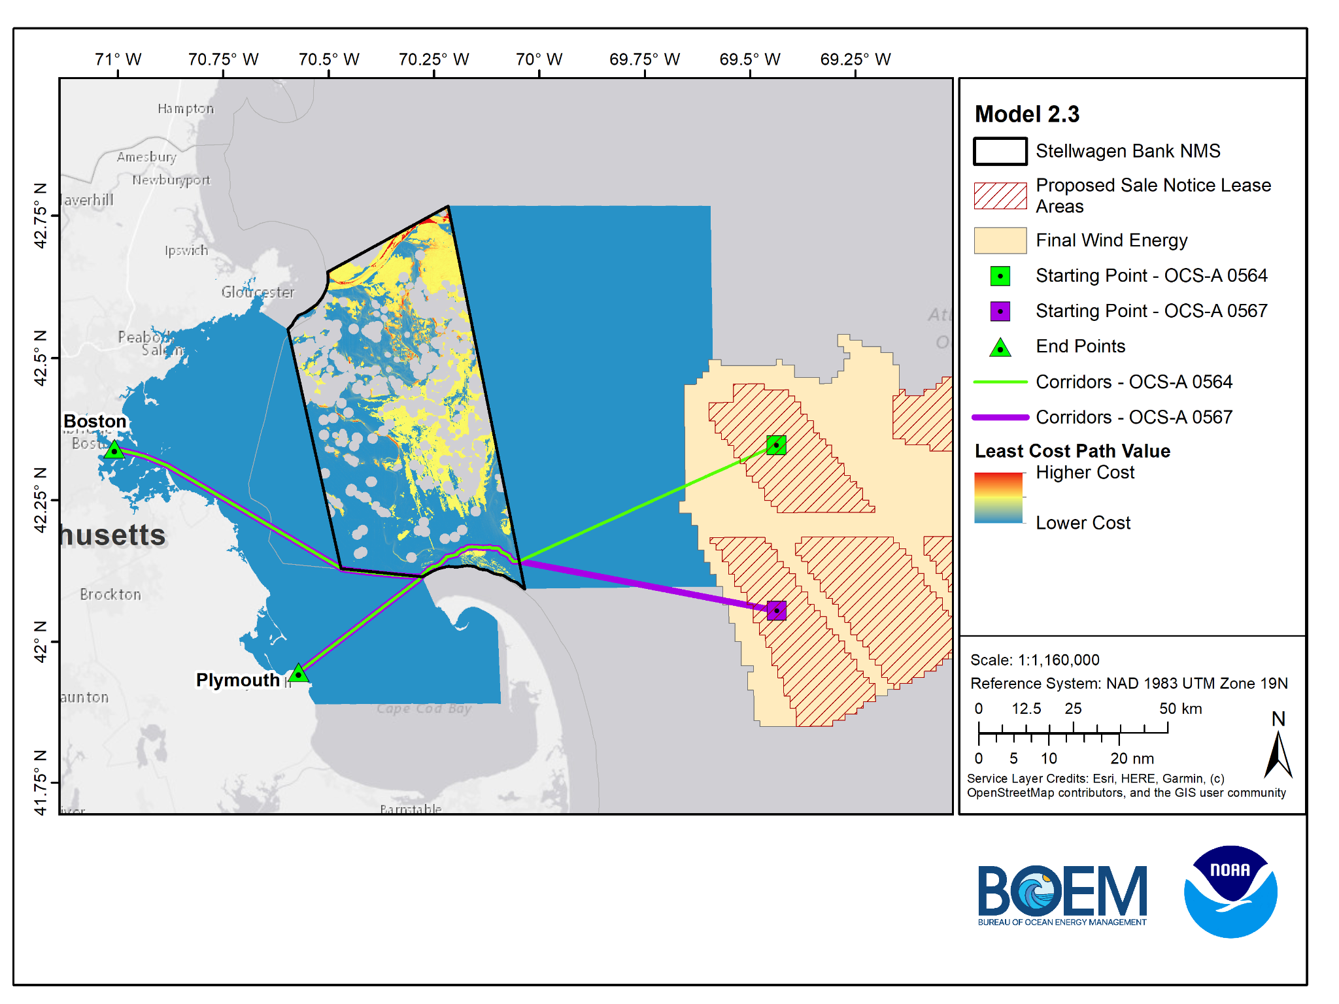
Model 2.3
NMS Base Case
OCS-A 0564 Lease
Boston Route = 90.3 miles
Plymouth Route = 68.1 miles
OCS-A 0567 Lease
Boston Route = 88 miles
Plymouth Route = 65.7 miles

Slide 20
Model 2.4
NMS Base Case (North of TSS)
Notes:
So this data inventory will be developed and updated as outreach and engagement continues with stakeholders.

Slide 21
Model 2.4 Data & Scoring
Model 2.4 Barriers
Data Sets | Score
NMS Sediment - Gravel | 0.5
Submarine Cables - (675-m setback) | 0.5
Slope (Flatter is better) | Increasing Linear
Barrier Data Sets | Score
Sites to Avoid (NMS provided) - (1000-m setback) | 0
Boulder Ridges (NMS provided) - (500-m setback) | 0
*Note recommended setback distances include an additional 500-m to account for a 1-km cable corridor, LCP analysis identifies a line, which is then given a 500-m setback
Notes:
So this data inventory will be developed and updated as outreach and engagement continues with stakeholders.

Slide 22
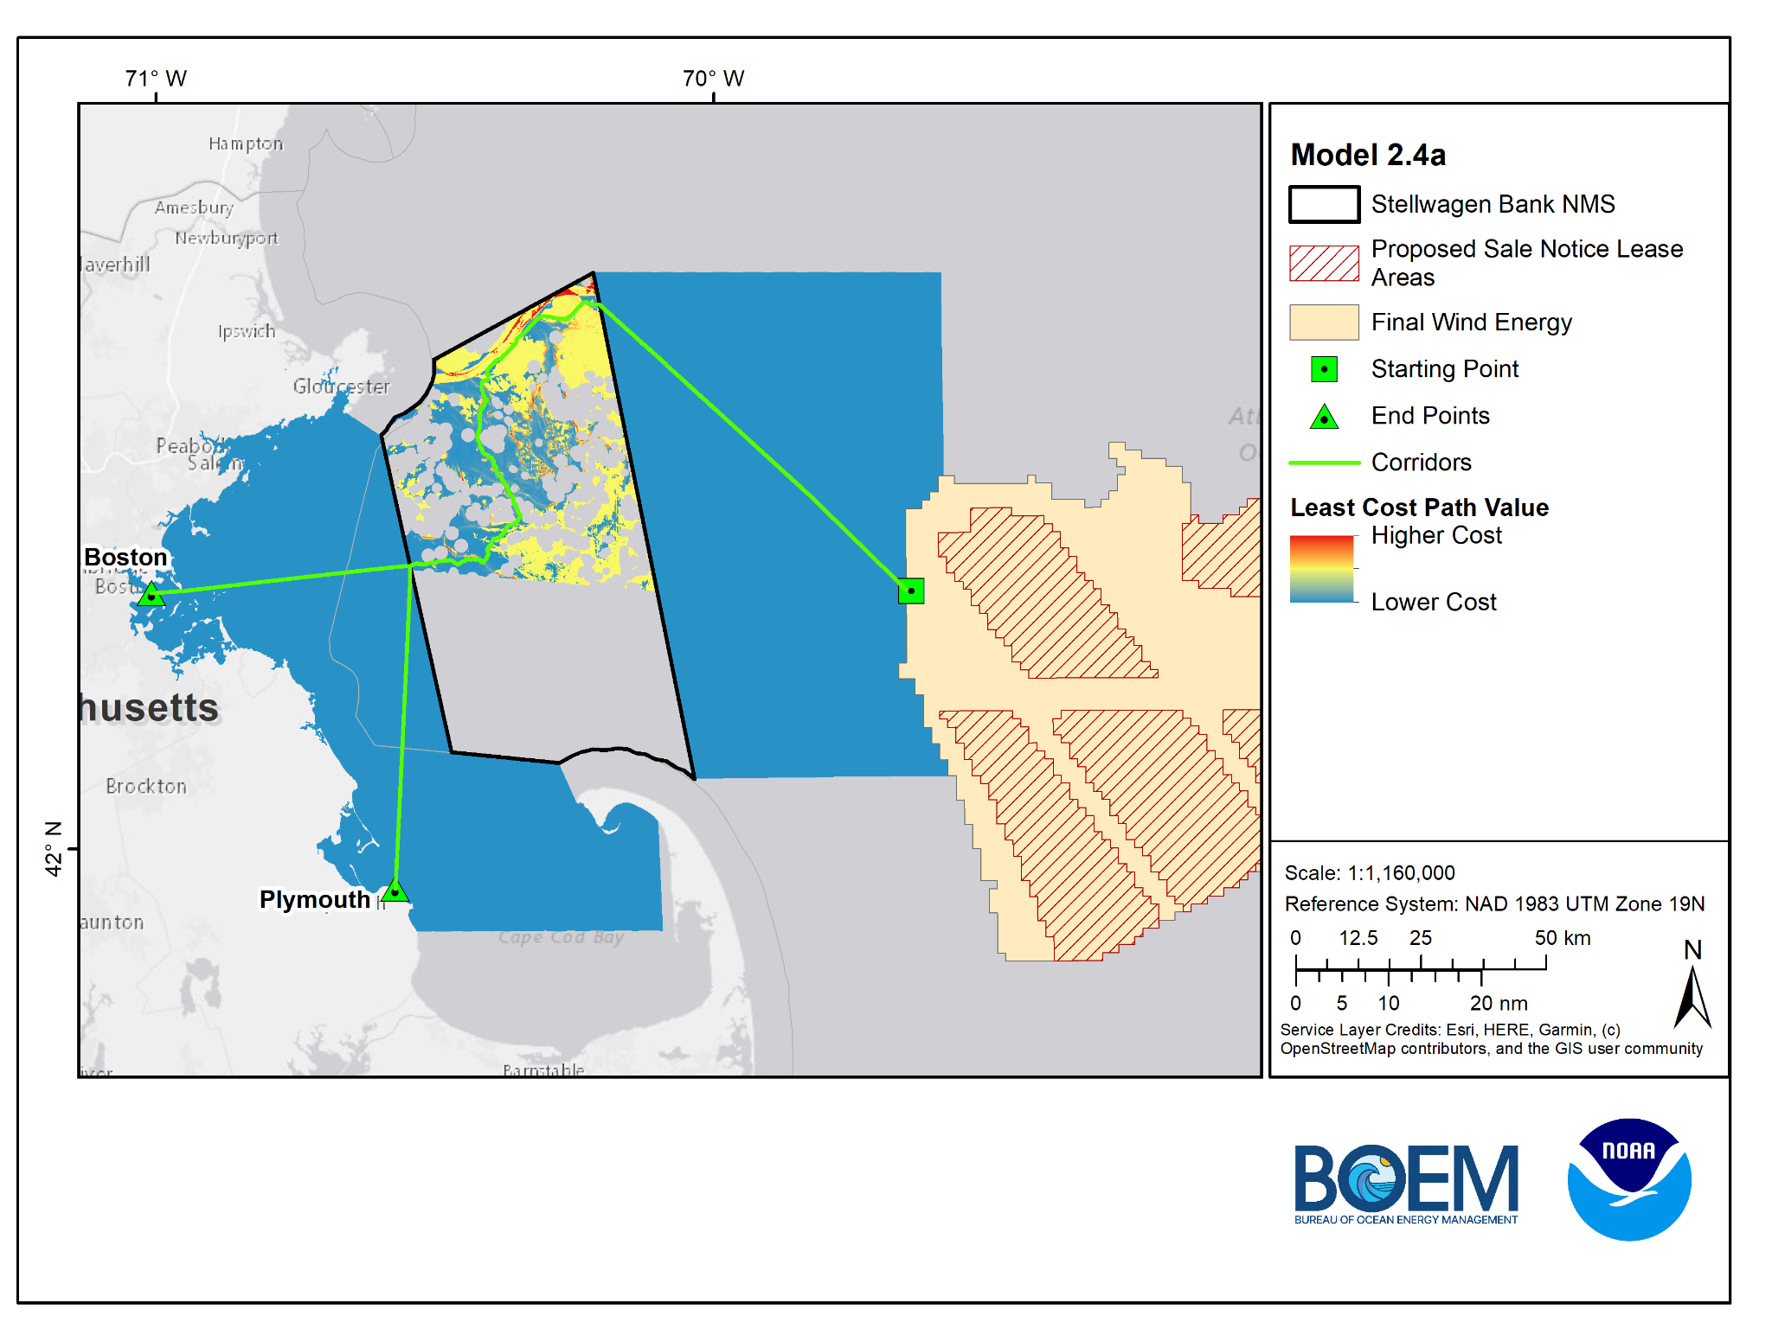
Model 2.4a
NMS Base Case
North of TSS
Boston Route = 106.2 miles
Plymouth Route = 112.1 miles

Slide 23

Model 2.4b
NMS Base Case
North of TSS
Exit northern portion of NMS
Boston Route = 90.5 miles
Plymouth Route = 106.3 miles

Slide 24
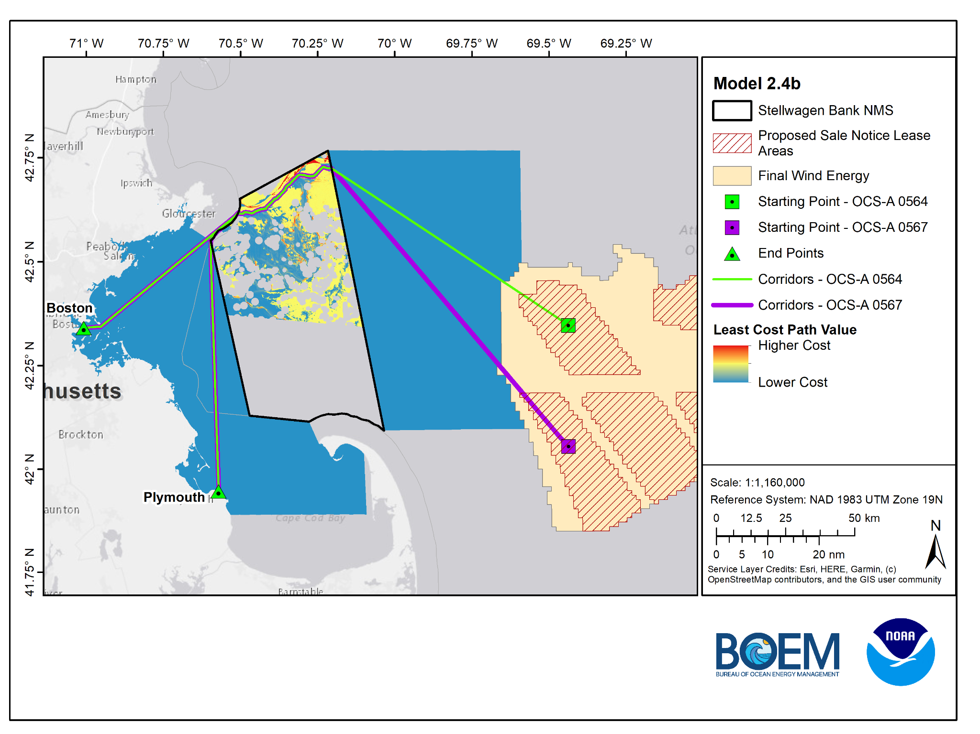
Model 2.4b
NMS Base Case
North of TSS
Exit northern portion of NMS
OCS-A 0564 Lease
Boston Route = 99.2 miles
Plymouth Route = 115 miles
OCS-A 0567 Lease
Boston Route = 113 miles
Plymouth Route = 129 miles

Slide 25
Model 2.5
NMS Base Case (South of TSS)
Notes:
So this data inventory will be developed and updated as outreach and engagement continues with stakeholders.

Slide 26
Model 2.5 Data & Scoring
Model 2.5 Barriers
Data Sets | Score
NMS Sediment - Gravel | 0.5
Submarine Cables - (675-m setback) | 0.5
Slope (Flatter is better) | Increasing Linear
Barrier Data Sets | Score
Sites to Avoid (NMS provided) - (1000-m setback) | 0
Boulder Ridges (NMS provided) - (500-m setback) | 0
*Note recommended setback distances include an additional 500-m to account for a 1-km cable corridor, LCP analysis identifies a line, which is then given a 500-m setback
Notes:
So this data inventory will be developed and updated as outreach and engagement continues with stakeholders.

Slide 27
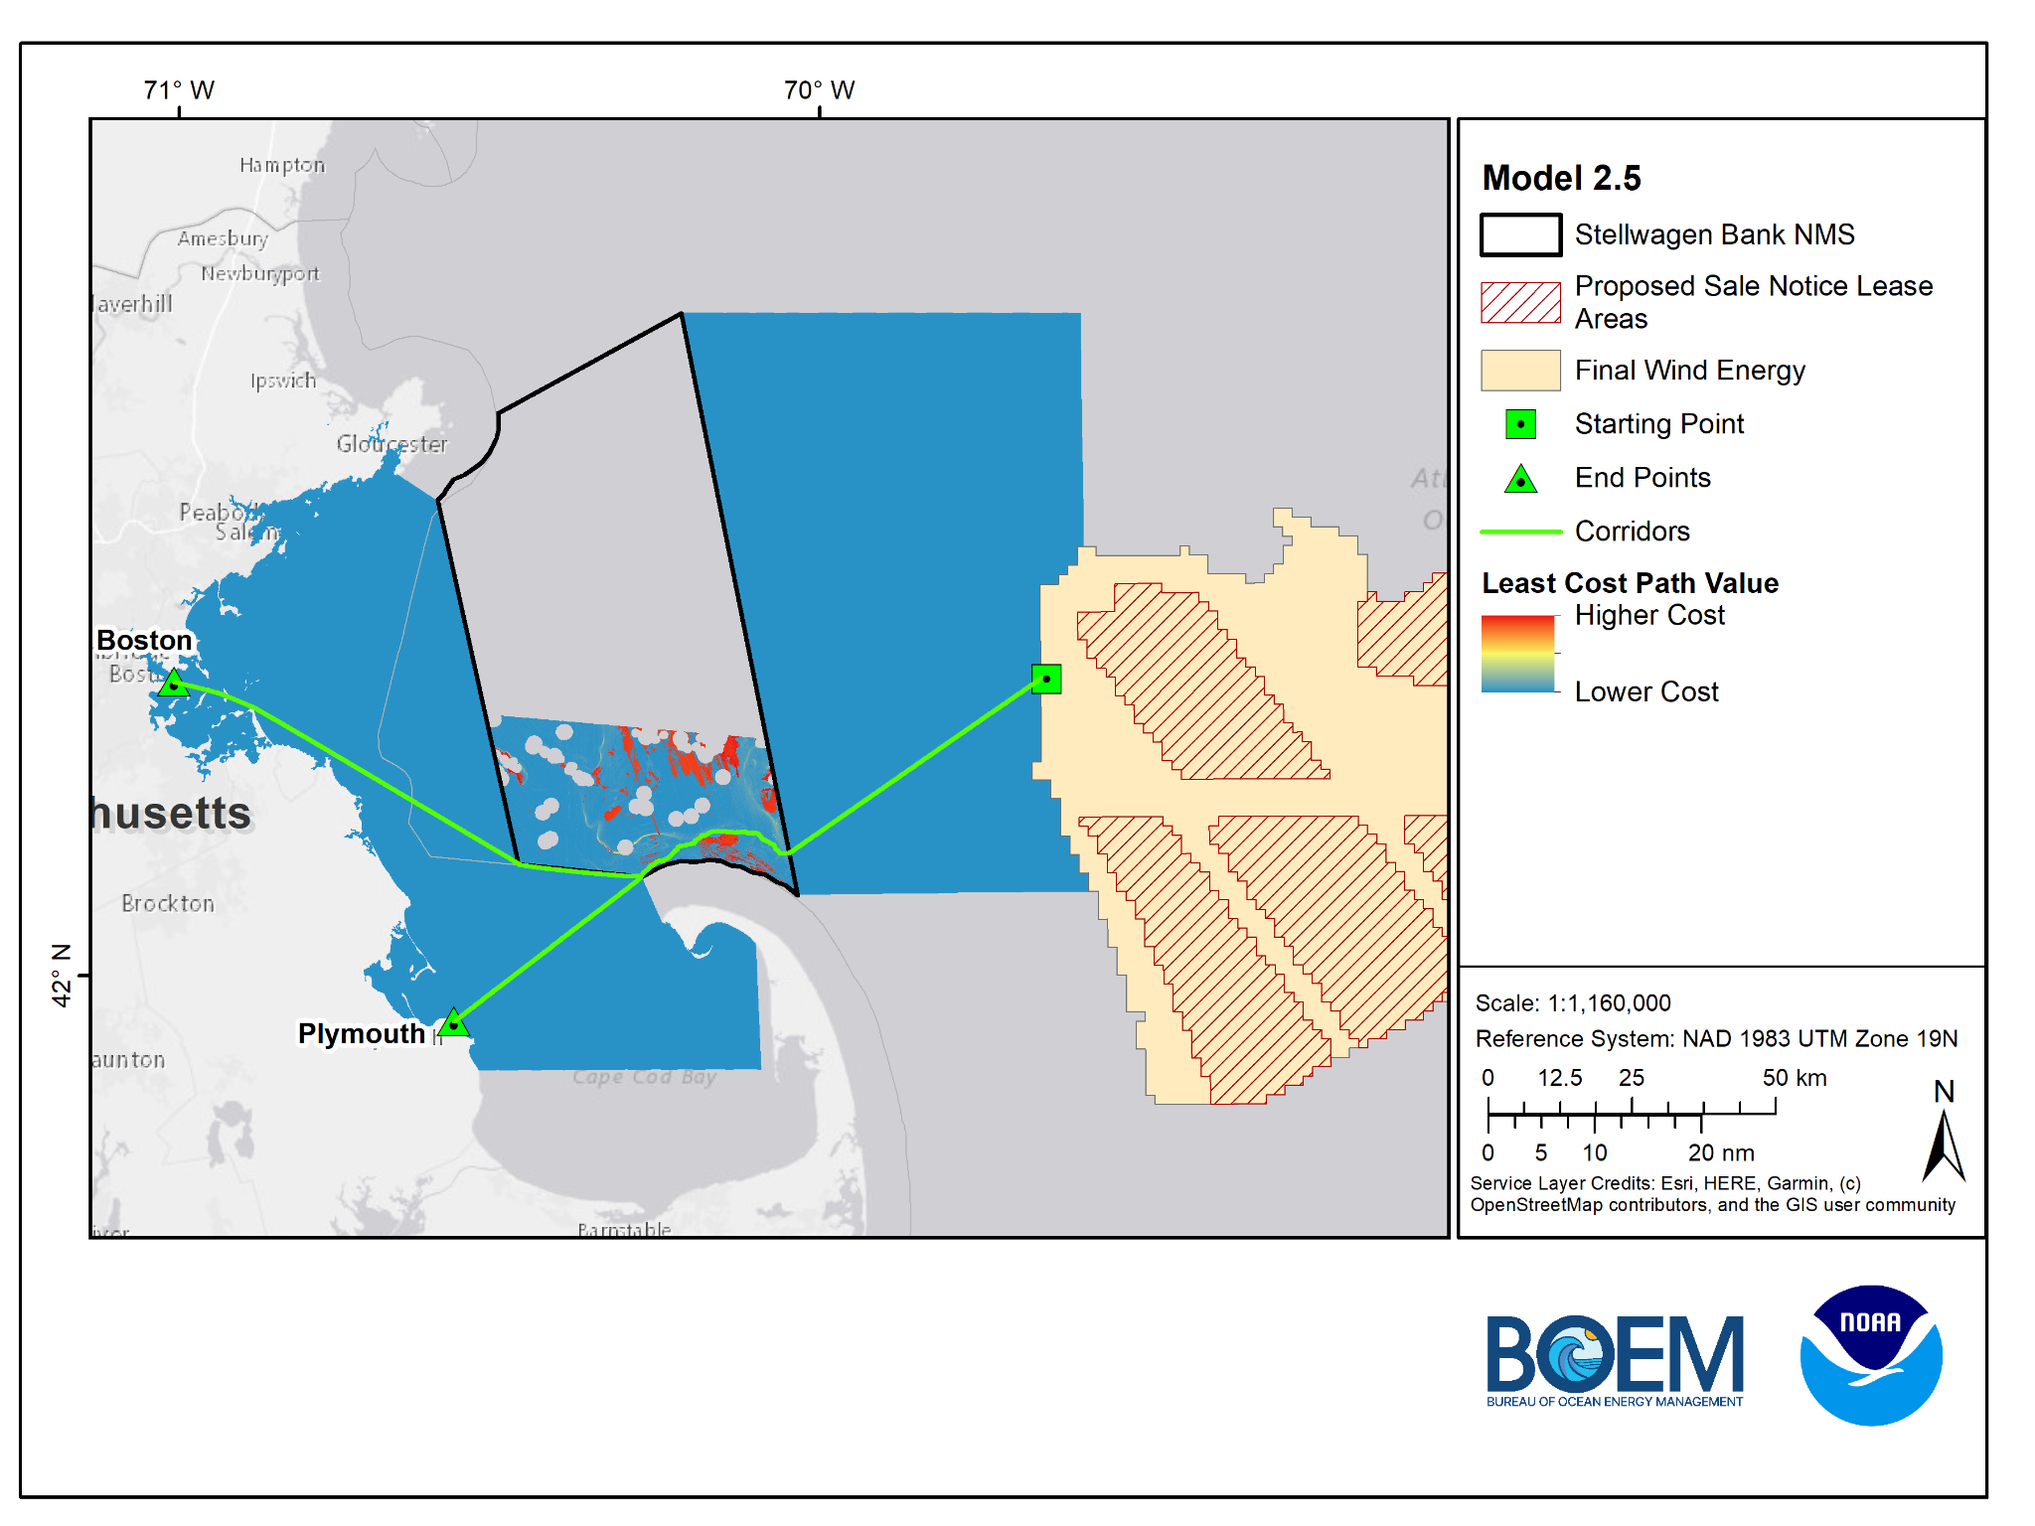
Model 2.5
NMS Base Case
South of TSS
Boston Route = 80.5 miles
Plymouth Route = 58.2 miles

Slide 28
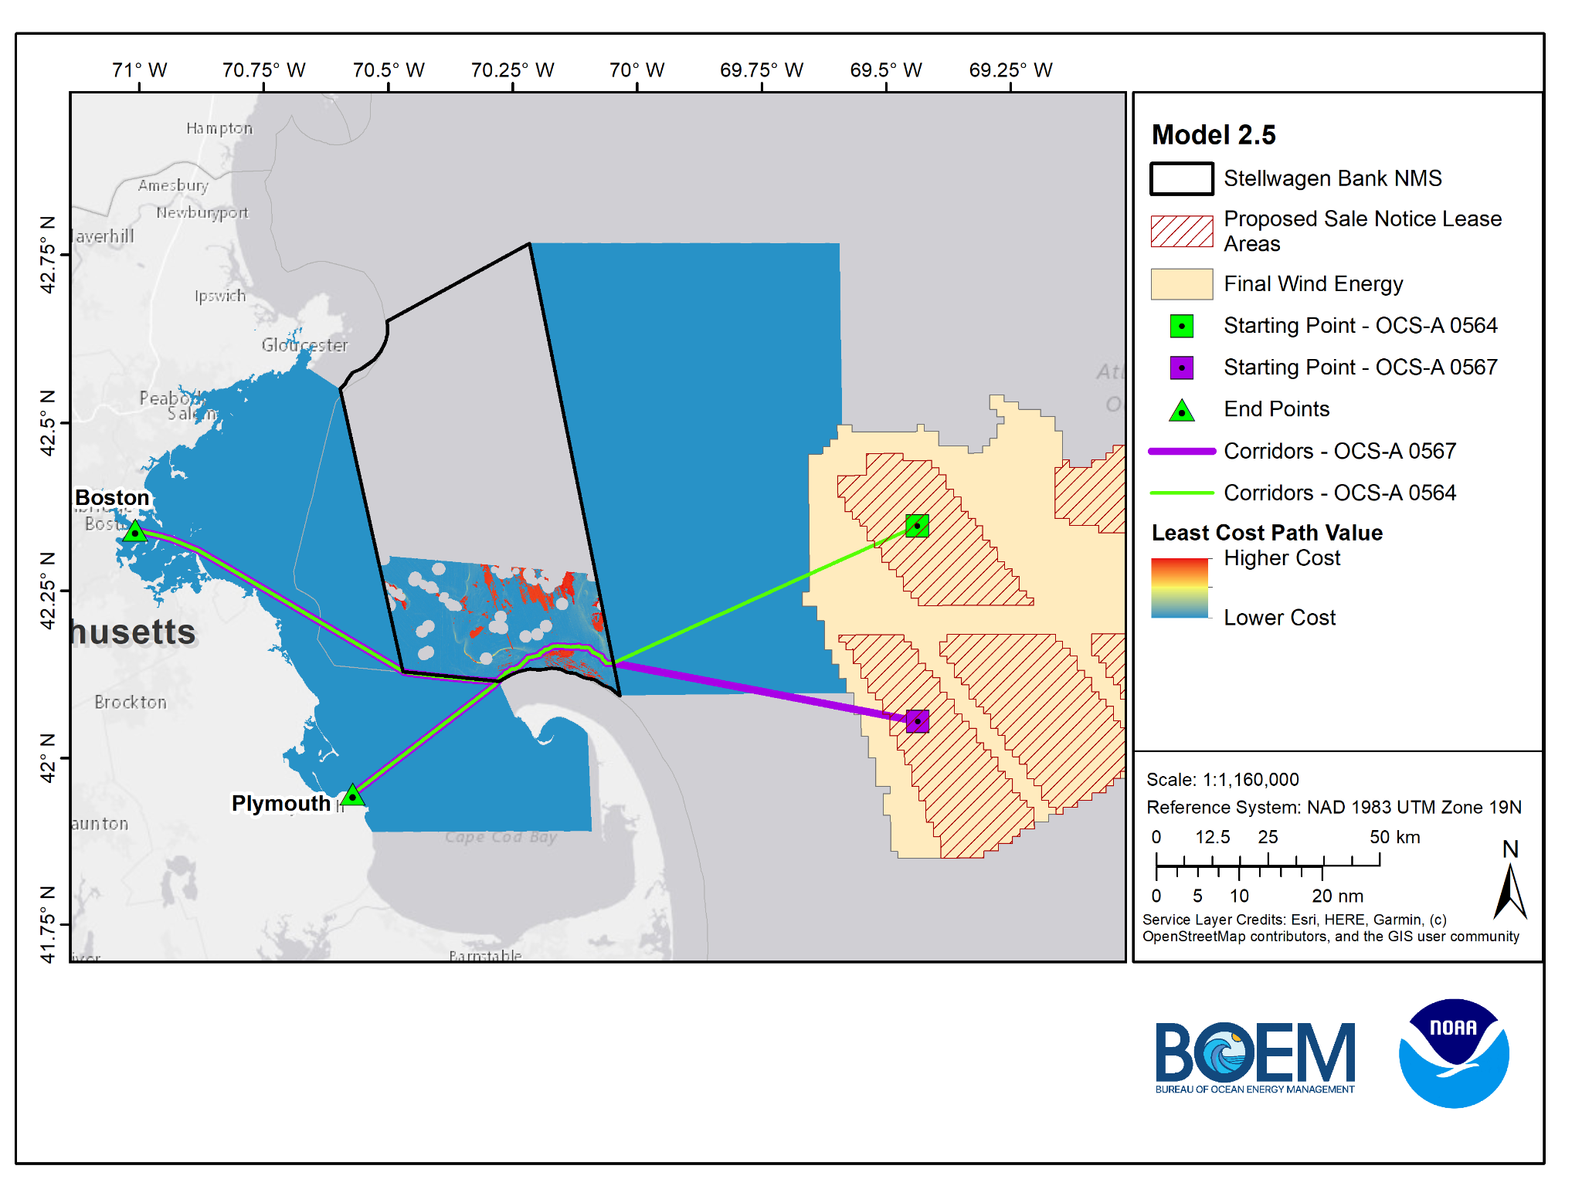
Model 2.5
NMS Base Case
South of TSS
OCS-A 0564 Lease
Boston Route = 90.3 miles
Plymouth Route = 68 miles
OCS-A 0567 Lease
Boston Route = 88 miles
Plymouth Route = 65.7 miles

Slide 29
Model 2.6
MA CZM (North TSS - Merrimack River end point)
Notes:
So this data inventory will be developed and updated as outreach and engagement continues with stakeholders.

Slide 30
Model 2.6 Data & Scoring
Data Sets | Score
Sediment (CONMAPSG) - Sand/Mud | 0.02
Sediment (CONMAPSG) - Mix | 0.4
Sediment (CONMAPSG) - Gravel | 0.6
Sediment (CONMAPSG) - Rock | 1
Cod Spawning IBS (High)/Telemetry (UD 50) | 0.8
Cod Spawning IBS (Low)/Telemetry (UD 90) | 0.2
Active and Inactive Disposal Sites - (500-m setback) | 0.8
Intertidal Flats - (500-m setback) | 0.2
Sand Patches - (500-m setback) | 1
Channel Areas - (600-m setback) | 1
Anchorage Areas - (600-m setback) | 0.8
Eelgrass Meadows - (675-m setback) | 0.4
Cable and Pipeline Areas - (675-m setback) | 0.4
Submarine Cables - (675-m setback) | 0.4
LNG Pipelines - (675-m setback) | 0.4
*Note recommended setback distances include an additional 500-m to account for a 1-km cable corridor, LCP analysis identifies a line, which is then given a 500-m setback
Notes:
So this data inventory will be developed and updated as outreach and engagement continues with stakeholders.

Slide 31
Model 2.6 Data & Scoring - Barriers
Barrier Data Sets | Score
Coral Points (MA CZM provided) - (675-m setback) | 0
Sites to Avoid (NMS provided) - (1000-m setback) | 0
Boulder Ridges (NMS provided) - (500-m setback) | 0
Cape 500-m setback from shore | 0
Notes:
So this data inventory will be developed and updated as outreach and engagement continues with stakeholders.

Slide 32
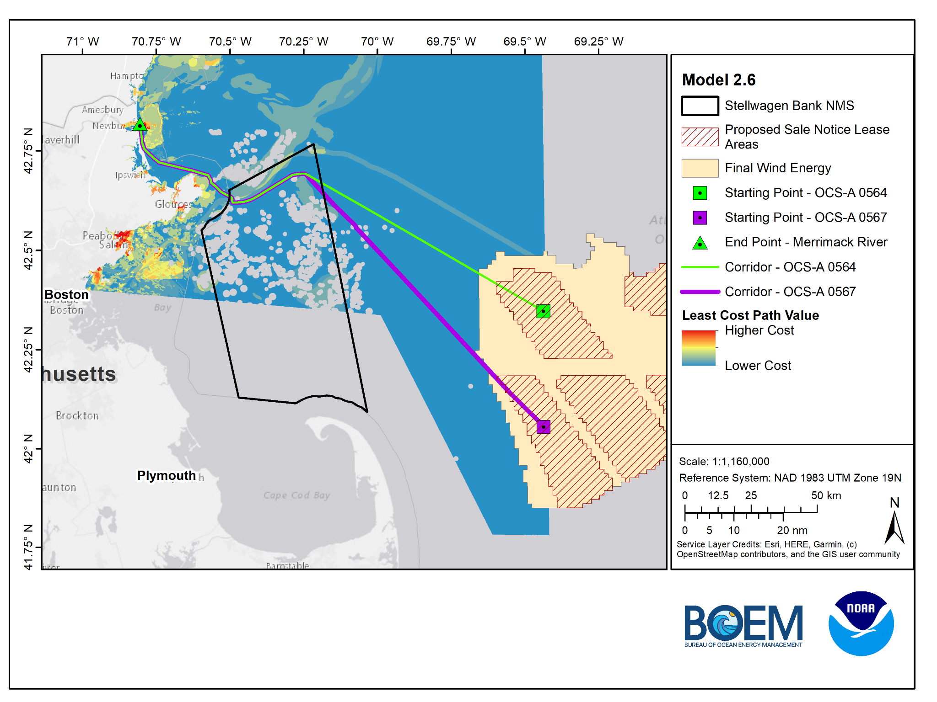
Model 2.6
MA CZM - North of TSS - Merrimack River end point
OCS-A 0564 Lease
Merrimack River = 85 miles
OCS-A 0567 Lease
Merrimack River = 97.8 miles

Slide 33
Model Comparison - Single Starting Point
Model 2.1 - MA CZM Base Case
Model 2.2 - Base Case No Cod
Model 2.3 - NMS Base Case
Model 2.4a - North of TSS
Model 2.4b - North of TSS
Model 2.5 - South of TSS

Slide 34
Model Comparison - Separate Lease Starting Points
Model 2.1 - MA CZM Base Case
Model 2.2 - Base Case No Cod
Model 2.3 - NMS Base Case
Model 2.4b - North of TSS
Model 2.5 - South of TSS
Model 2.6 - N. TSS Merrimack

